Slide 1

HEART DISEASE PREDICTION
Team :
Matrix Masters

Slide 2
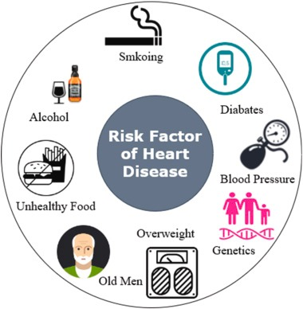
INTRODUCTION
Heart disease, mainly A heart attack usually occurs when a blood clot blocks blood flow to the heart. Without blood, tissue loses oxygen and dies. It is widely considered a direct threat to human life and health. A great deal of effort has been devoted to trying to prevent and reduce the incidence of heart disease with a timely and effective method. Computational technology and statistical approaches have been popular in discovering the relationship between heart diseases and patients’ health conditions. They can help predict the potential risk of heart disease based on the patient’s underlying physical condition in advance, thereby reducing the probability of dying from a heart attack. Few machine learning techniques have been proven quite handy in predicting the risk of heart disease effectively, which helps researchers and doctors make better judgments about heart disease.

Slide 3

BUSINESS OBJECTIVE
“Matrix Masters” group was approached to work for a medical institution that wants to improve the heart health of its patients. We have been asked to identify a classifier based on the data that would predict the CLASS of new patients so they can be enrolled for treatments based on their demographic data. Also, we plan to calculate the Net Benefit to the institution using each model and decide on the best model based on the performance metrics and Net Benefit.

Slide 4
PROBLEM STATEMENT
Class | Type of issue | Type of Treatment | Cost(USD)
0 | No heart health issues. | Checkup | 100
1 | Slight heart health issues | Minor | 200
2 | Moderate heart health issues | Moderate | 300
3 | High heart health issues | Significant | 400
4 | Extreme heart health issue | Extreme | 500
We would be identifying a classifier that would predict the CLASS of new patients so they can be enrolled for treatments based on their demographic data and also that maximizes the overall Net Benefit.
NET_BENEFIT = BENEFIT - COST.
The BENEFITs of the treatments are as follows:
If the classification is correct and the correct treatment is given to the patient:
500 * (TRUE_CLASS + 1)
If an incorrect classification is made and the wrong intervention is given to the patient: 0

Slide 5


WHO USES IT
Health care
Insurance

Slide 6

ABOUT THE DATASET
DATA SOURCE: https://archive.ics.uci.edu/dataset/45/heart+disease
DATA PROVENANCE: This data is created by Andras Janosi, William Steinbrunn, Matthias Pfisterer, Rober Detrano. This is also licensed under the Creative Commons Attribution 4.0 license which allows for the sharing and adaptation of the datasets for any purpose, provided that appropriate credit is given.
ABOUT DATA: This data contains 76 attributes, but all published experiments refer to using a subset of 14 of them. In particular, the Cleveland database is the only one that has been used by ML researchers to date. The "goal" field refers to the presence of heart disease in the patient. It is integer valued from 0 (no presence) to 4. Experiments with the Cleveland database have concentrated on simply attempting to distinguish presence (values 1,2,3,4) from absence (value 0). The names and social security numbers of the patients were recently removed from the database, replaced with dummy values.

Slide 7
DATASET DESCRIPTION
Variable Name | Descriptions
Age | Age of the patient
Sex | Sex of the patient
exang | Exercise induced angina: 1 = yes; 0 = no
cp | Chest Pain type : 1 = typical angina; 2 = atypical angina; 3 = non-anginal pain; 4 = asymptomatic;
trtbps | Resting blood pressure (in mm/Hg)
chol | Cholestoral in mg/dl fetched via BMI sensor
fbs | Fasting blood sugar: 1 = fasting blood sugar > 120 mg/dl; 0 = fasting blood sugar ≤ 120 mg/dl
restecg | Resting electrocardiographic results: 0 = normal; 1 = having ST-T wave abnormality (T wave inversions and/or ST elevation or depression of > 0.05 mV); 2 = showing probable or definite left ventricular hypertrophy by Estes’ criteria;
thalach | Maximum heart rate achieved
old peak | ST depression induced by exercise relative to rest
slp | The slope of the peak exercise ST segment
thall | Thalassemia: 0 = null; 1 = fixed defect; 2 = normal; 3 = reversable defect
num | diagnosis of heart disease

Slide 8
Slide 1
Data
Pre processing
Modelling
Metrics
Observations
Conclusion
LOAD THE DATA TO YOUR IPYNB FILE
PERFORM THE PRE-PROCESSING
SPLIT THE DATASET INTO TRAIN AND TEST
SCALING
FIT THE BASE MODEL
HPERPARAMETER TUNING
EVALUATING METRICS
VISUALIZING THE PERFORMANCE METRICS
OBSERVATIONS
CONCLUSION
When scaling, group all elements to be scaled. Scale as needed. Use the “Increase Font Size,” “Decrease Font Size” buttons or manually change the font size for the editable text. Delete unwanted elements. Change the line weight of the circles or connecting bars as needed.

Slide 9

DATA PREPROCESSING STEPS
Importing the CSV file
Assigning column names
Checking for missing values
Imputing the missing values
Dropping few columns based on correlation matrix
Transforming the categorical columns using One Hot Encoding method

Slide 10
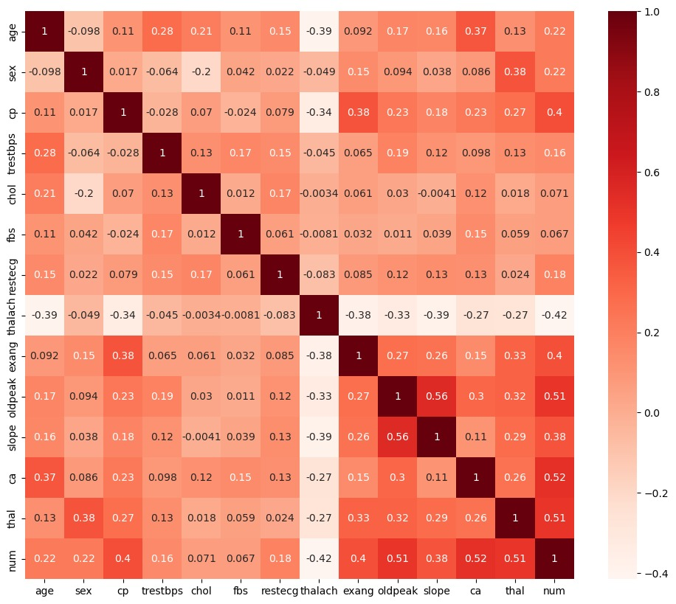
CORRELATION MATRIX
Dropped Columns
Sex
Fbs
slope

Slide 11
MODELS USED FOR PREDICTION
KNN
SVC
DECISION TREE

Slide 12
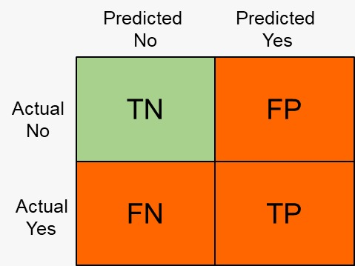
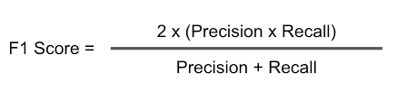
METRIC USED
We have projected F1 as the primary evaluation metrics for this model. The F1 score is the harmonic mean of precision and recall. It provides a balance between these two metrics and can be useful when we want to consider both false positives and false negatives.

Slide 13
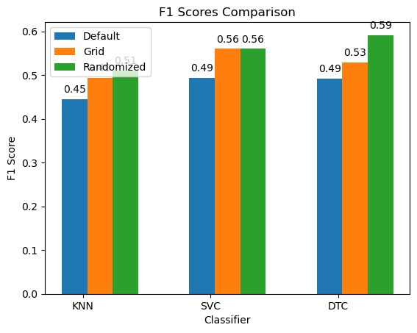
RESULTS
F1 Score Comparison

Slide 14
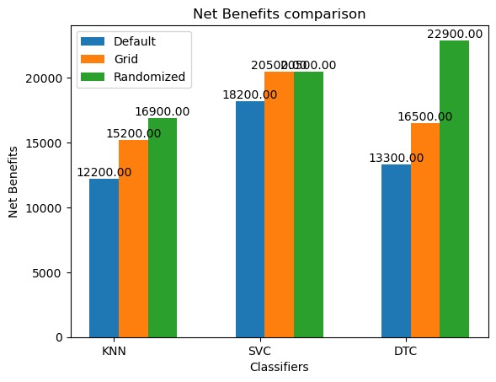
RESULTS
Net Benefits Comparison

Slide 15

CONCLUSION
F1 Score : The Decision Tree with Randomized Search outperformed the other models, with an F1 Score of 0.59. This suggests that the Decision Tree is better at correctly classifying patients with heart health issues.
Net Benefit : However, when evaluating the Net Benefit, Decision Tree with hyperparameter tuning (Randomized Search) lead to higher net benefit with 22900. This indicates that Decision Tree provides better economic value.
Overall Recommendation : Considering the goal of maximizing the overall Net Benefit along with good F1 score, the Decision Tree with hyperparameter tuning (Randomized Search) appears to be the best choice.
Bases on the scores, we would suggest the medical institution to use the Decision Tree model with hyperparameter tuning (Randomized search) in order to classify the patients for better treatments.

Slide 16

PREVIOUS WORK
Their objective was to predict if a patient has heart disease or not.
Two approaches in preprocessing :
With feature Selection
Without feature selection
Used Lasso algorithm for Feature selection.
Used “Accuracy” of the model as the primary evaluation metric.
Used Machine Learning models and Sequential Deep Learning model and compared the accuracy.
Machine Learning models proved to be better performing.
Link of the research paper being referred : https://www.ncbi.nlm.nih.gov/pmc/articles/PMC8266441/

Slide 17

FURTHER IMPROVEMENTS
Dataset could be large.
Can try of different methods for feature selection.
Can include other normalization techniques.
Can include deep learning techniques .
Can include different metrics like sensitivity, loss function etc.

Slide 18


